Slide 1
Capstone Project
Java Selenium Batch - 4
Name : Pandiparthi Pavitra
Superset ID :3577120

Slide 2
Global SQA Banking

Slide 3
Contents:
Project Overview
Project Structure
Feature Files
Runner Class
Step Definitions
POM Class
Utility Class
Base Class
Report class
Project Config & Build Mngt
Extent Reports
Console Output
GIT URL

Slide 4
Project Overview
This project automates the Global Bank application using Selenium with Java, Cucumber BDD, TestNG, and Maven. It ensures modular design, reusable utilities, cross-browser testing, and professional reporting with screenshots.

Slide 5
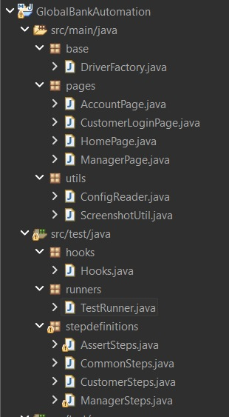
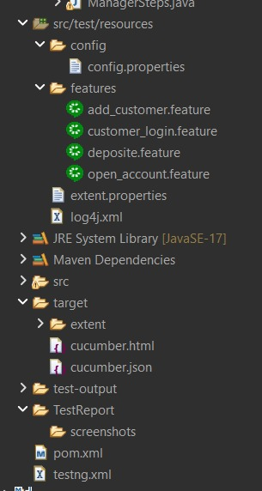
Project Structure

Slide 6
Feature files
1.Add Customer (Manager Role)
Positive: Valid customer details → Success message with ID.
Negative: Empty fields / duplicate → Error or new ID.
2.Open New Account (Manager Role)
Positive: Select customer + currency → Success message with Account No.
Negative: No selection → Error message.
3.Customer Login
Positive: Select valid customer → Redirect to Account Page.
Negative: No selection → Error “Please select a customer.”
4.Deposit Amount (Customer Role)
Positive: Enter valid amount → Deposit successful.
Negative: Invalid/negative/blank → Error message.

Slide 7
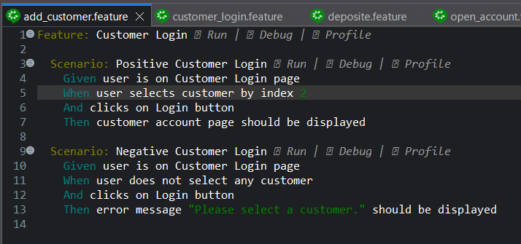
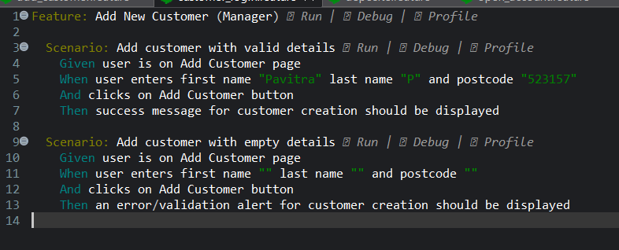
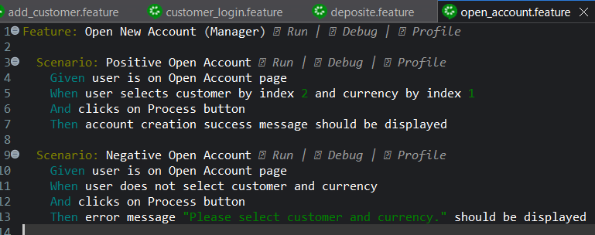
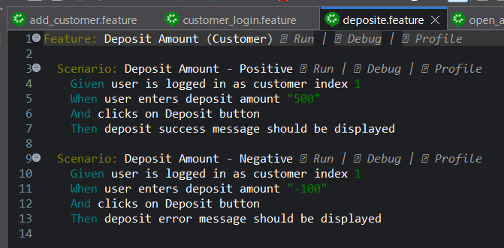
Feature files-Screenshots

Slide 8
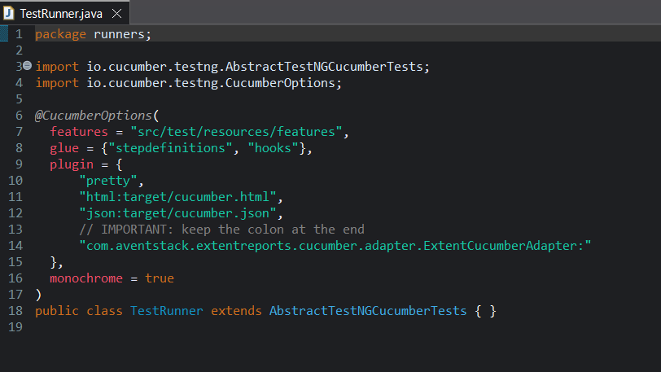
Runner Class
The runner class executes all feature files, integrates Cucumber with TestNG, and generates automation reports.
TestRunner.java -
The TestRunner.java class integrates Cucumber with TestNG to execute all feature files in the project.
It specifies feature file locations, step definitions, and generates HTML and JSON reports for automation results

Slide 9
Step Definitions
CustomerSteps.java – Contains step definitions for customer login and deposit. It automates customer actions by selecting values from dropdowns and validates successful account page navigation.
ManagerSteps.java – Defines steps for Add Customer and Open Account. It handles form inputs and verifies success messages with generated Customer IDs and Account Numbers.
CommonSteps.java – Holds reusable steps like launching the app, navigation, clicks, and waits. It reduces duplication and ensures stable execution across scenarios.
AssertSteps.java – Manages assertions for positive and negative outcomes. It validates success/error messages and captures screenshots to include in reports.
Hooks.java – Controls the test lifecycle. Initializes WebDriver before scenarios, closes it afterward, and captures screenshots on scenario success or failure for reporting.

Slide 10
Page Object Model (POM)
The Page Object Model provides a structured, reusable layer for automation by representing each page of the application as a class. This improves maintainability, readability, and reduces code duplication.
HomePage.java – Represents the landing page and provides navigation methods for Manager and Customer login.
ManagerPage.java – Encapsulates Add Customer and Open Account workflows, handling inputs, dropdowns, and verifying success confirmations.
CustomerLoginPage.java – Manages customer login via dropdown selection and validates successful redirection to the account page.
AccountPage.java – Models account operations like Deposit, Withdraw, and Transactions, validating balances and messages.

Slide 11
Base Class
DriverFactory.java
Creates and manages the WebDriver instance for test execution.
Maximizes the browser window and applies basic setup before scenarios.
Initializes Chrome, Firefox, and Edge drivers as per configuration.
Ensures a fresh and stable driver is provided for every scenario.

Slide 12
Utility Class
ConfigReader.java
Reads values from config.properties (URL, browser type, timeouts).
Provides configuration dynamically without hardcoding values.
ScreenshotUtil.java
Captures screenshots during test execution.
Integrated with Hooks and Step Definitions to attach evidence in reports.

Slide 13
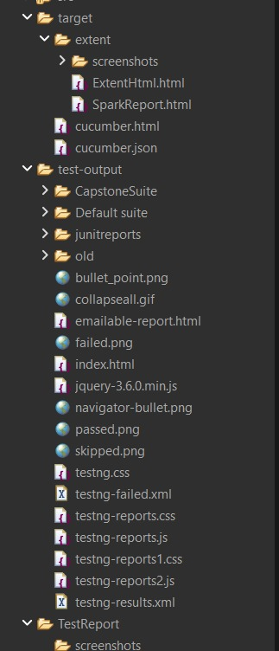
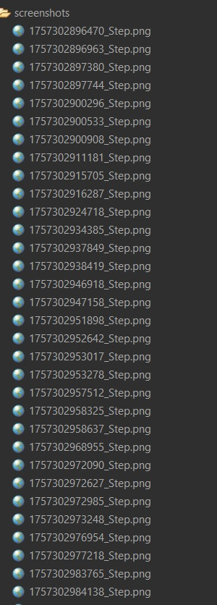
Report class

Slide 14
Project Configuration & Build Management
Testng.xml
Defines the TestNG suite, specifying which classes or packages to run..
Ensures the Cucumber TestRunner is executed for all feature files.
pom.xml
Manages project dependencies, including Selenium, Cucumber, TestNG, Apache POI, and ExtentReports.
Configures Maven plugins for build, test execution, and report generation.

Slide 15
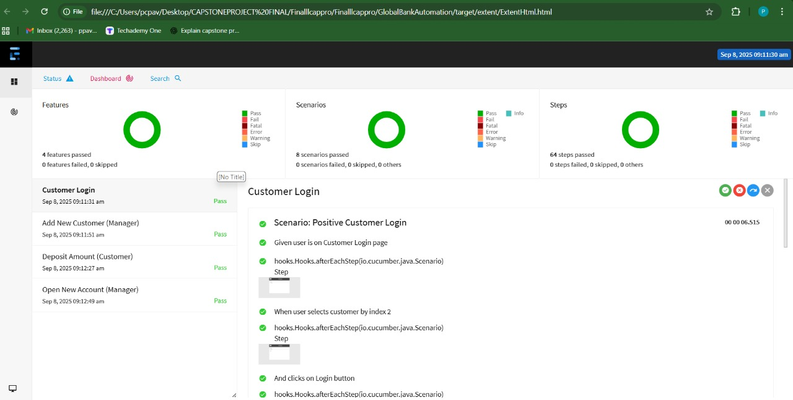
Extent Report

Slide 16
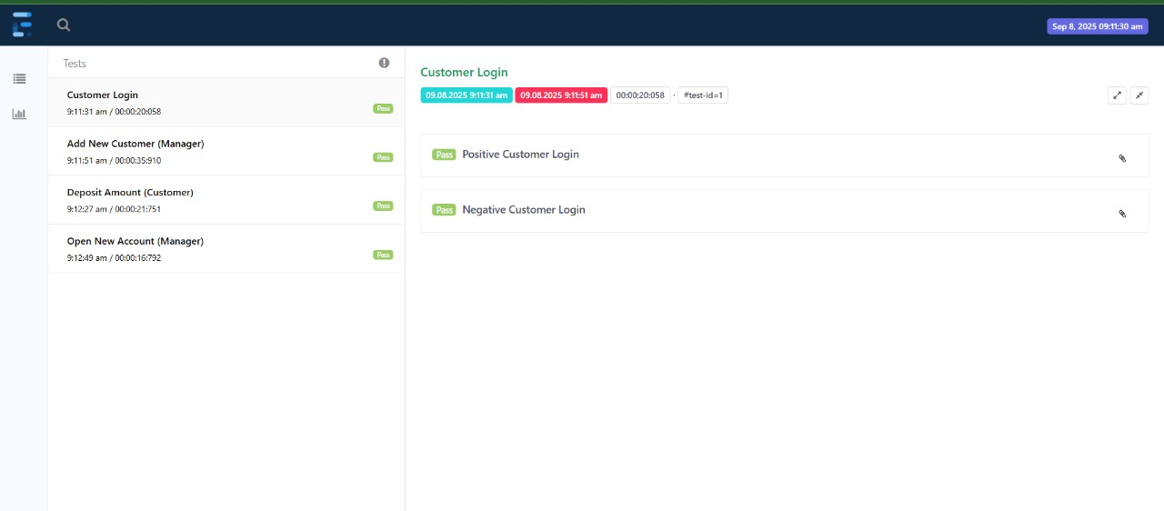
SparkReport.html

Slide 17
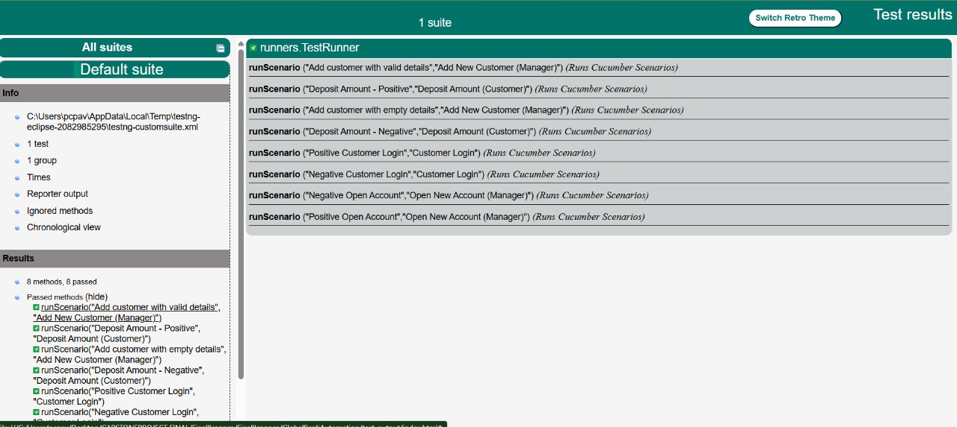
index.html

Slide 18
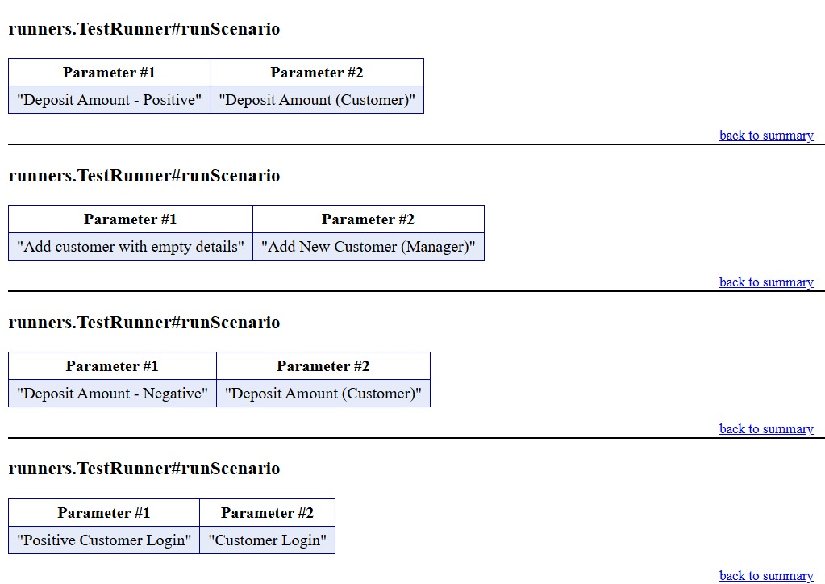
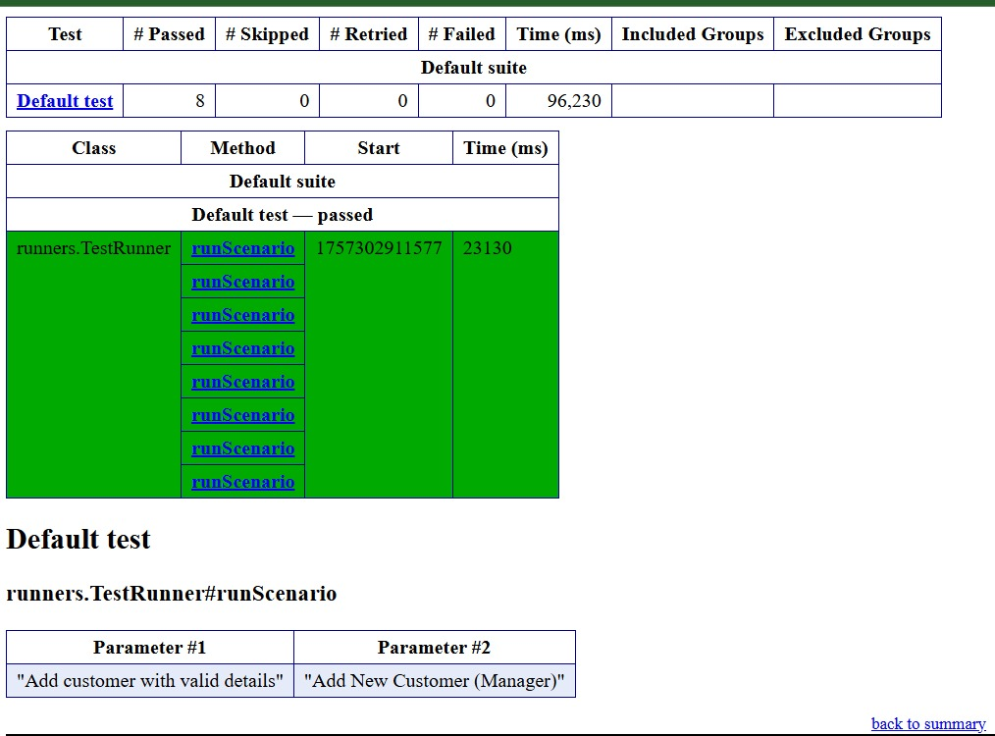
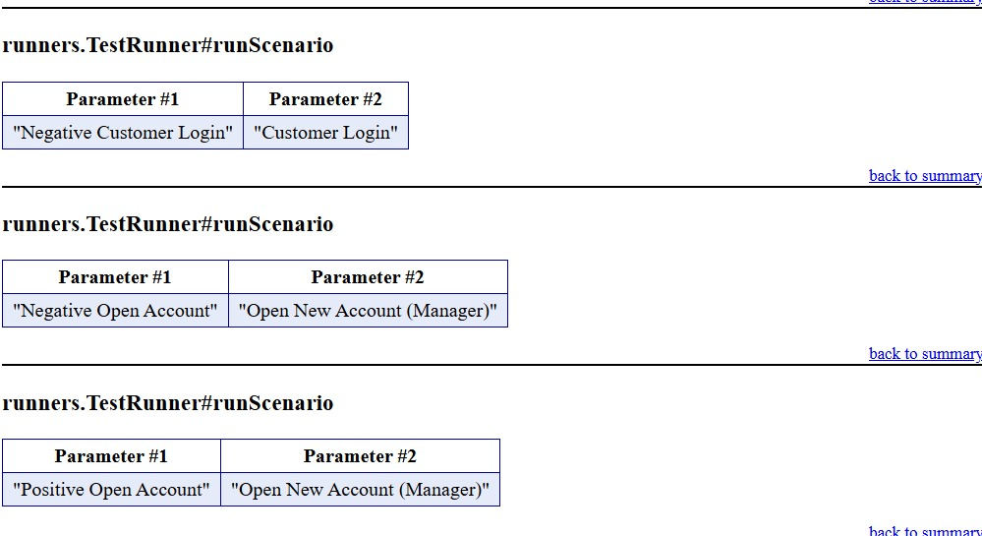
Emailable-report.html

Slide 19
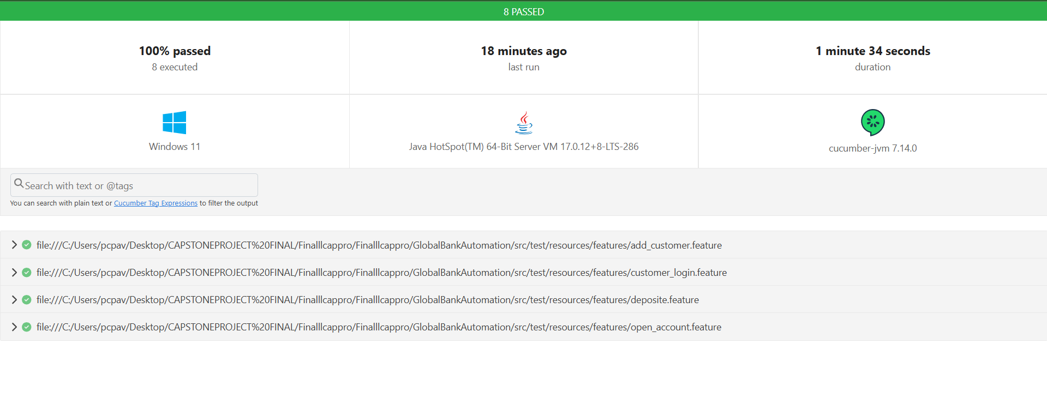
Cucumber.html

Slide 20
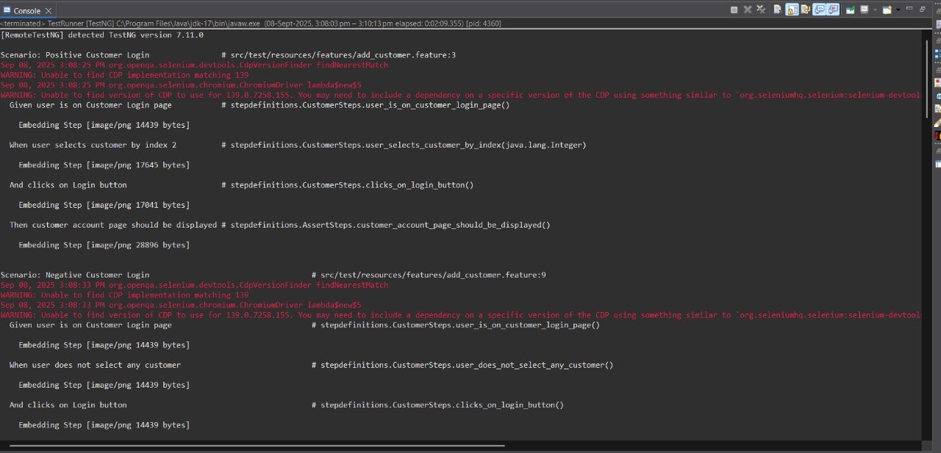
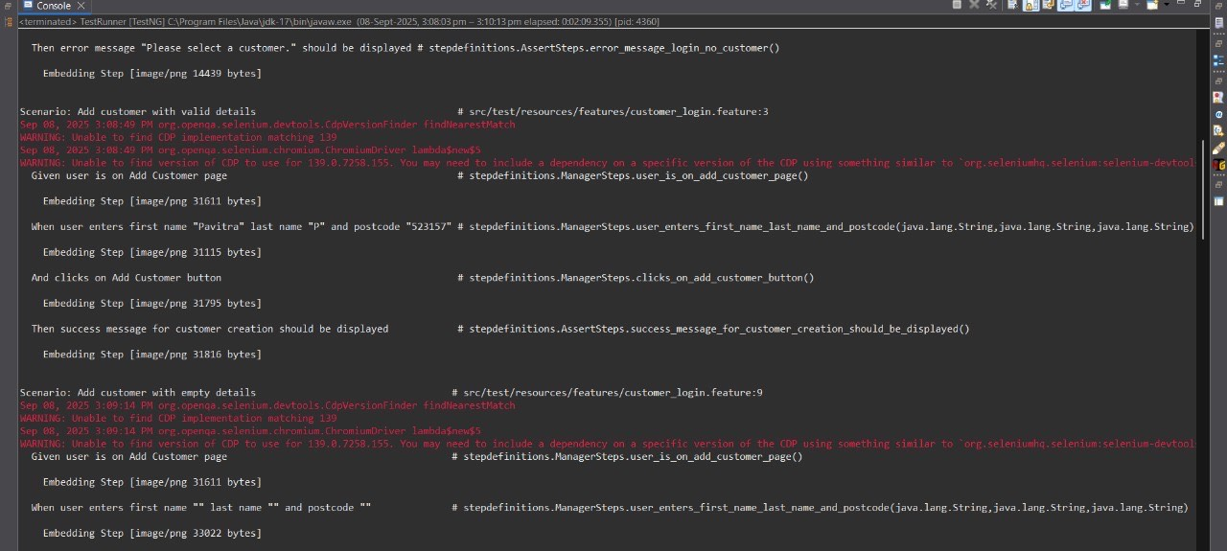
Console Output-1

Slide 21
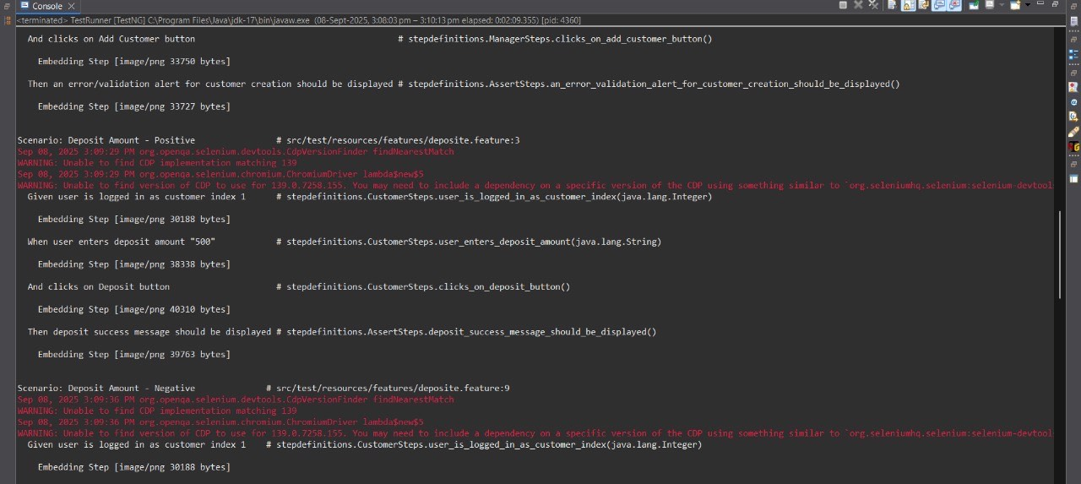
Console Output-2

Slide 22
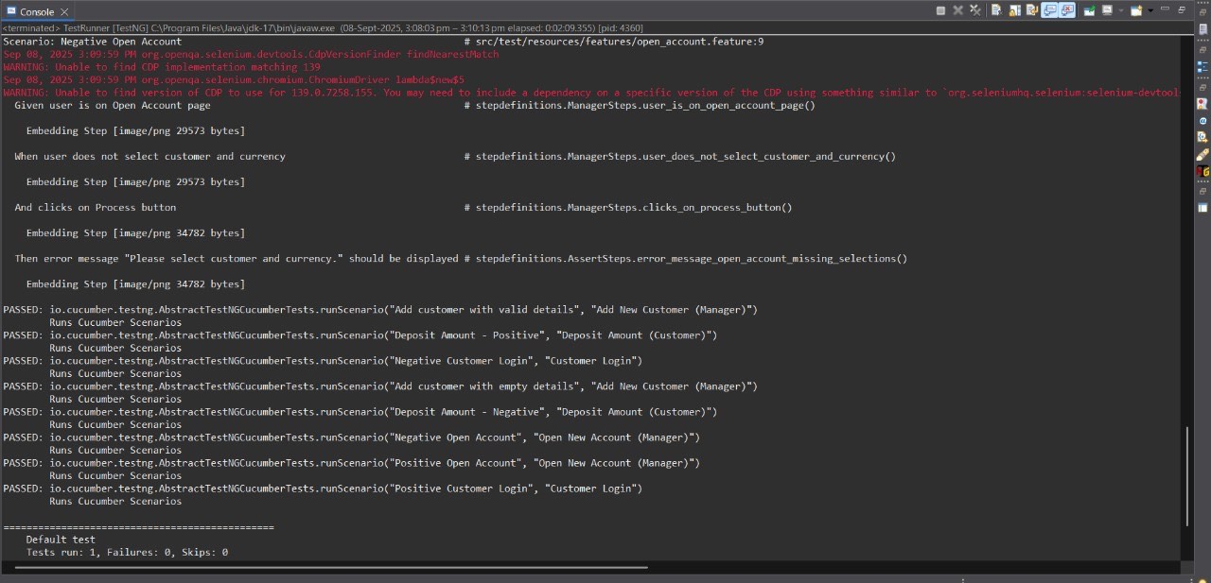

Slide 23
Git Url
https://github.com/PandiparthiPavitra/CapstoneProject-GlobalBanking-Automation.git

Slide 24
Thank You

